Slide 1
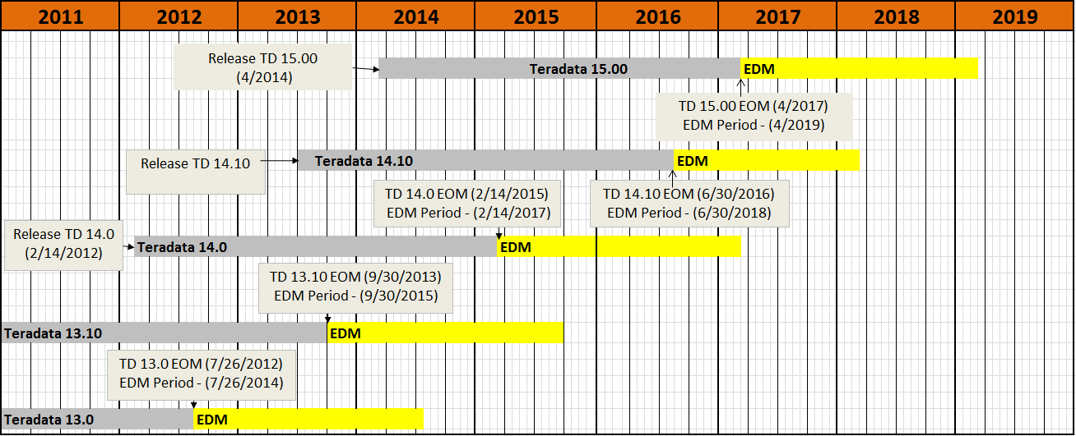
DBMS Support Roadmap

Slide 2
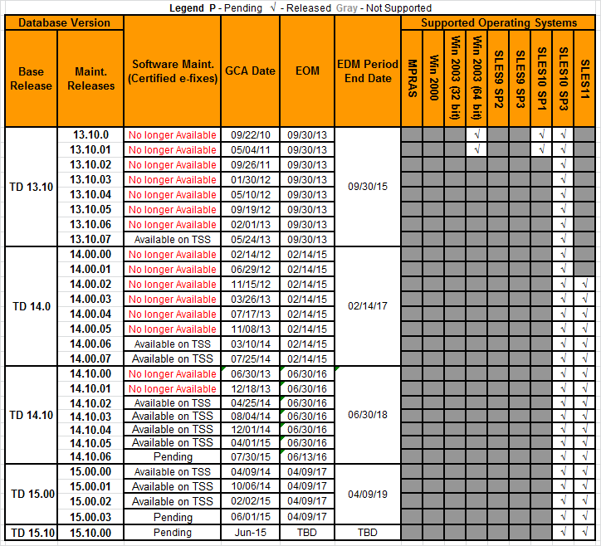
DBMS Support Roadmap

Slide 3
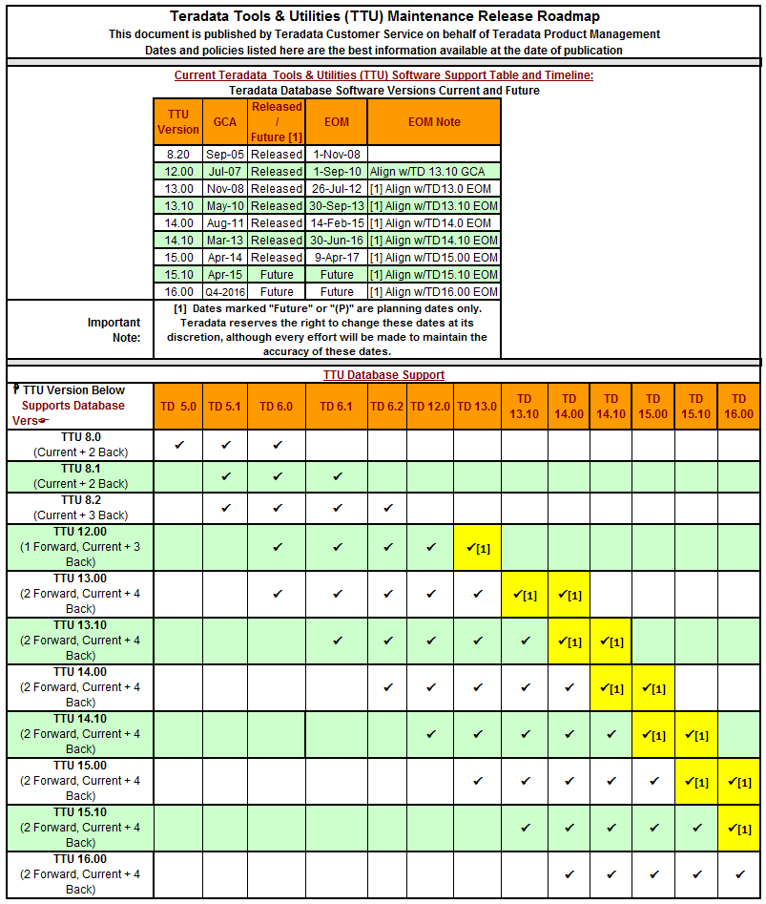
TTU Roadmap

Slide 4
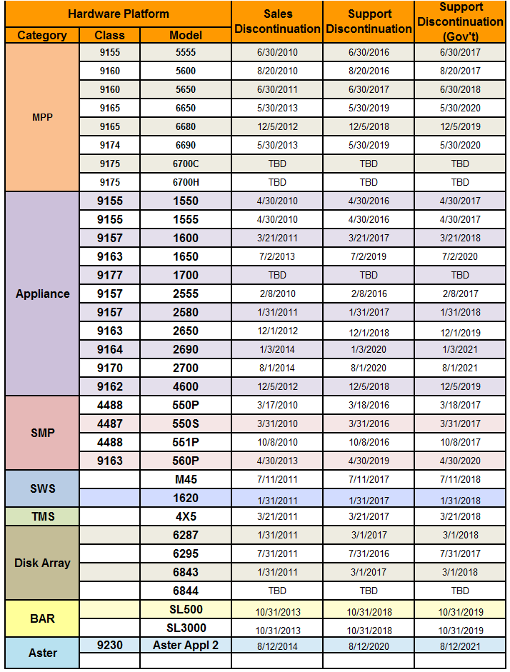
Platform Roadmap

Slide 5
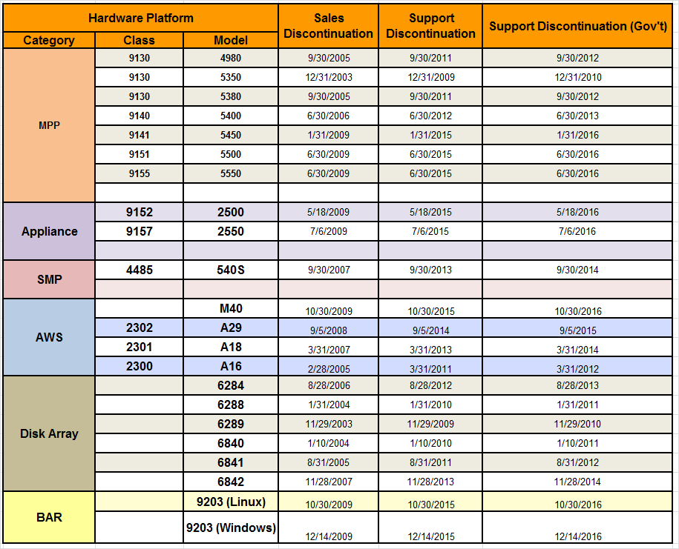
Platform Roadmap (cont.)

Slide 6
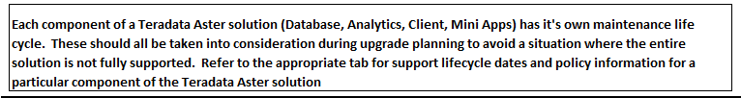
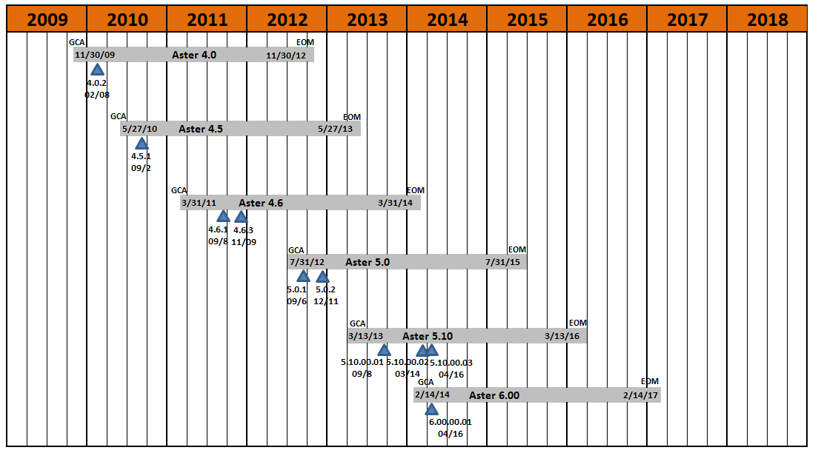
Aster Support Roadmap

Slide 7
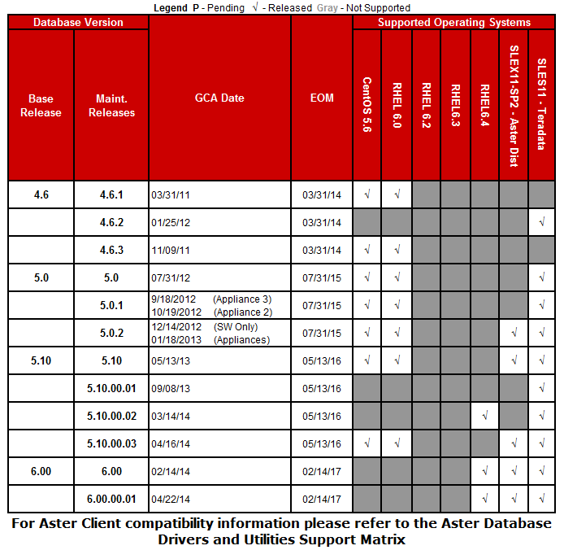
Aster Support Roadmap

Slide 8
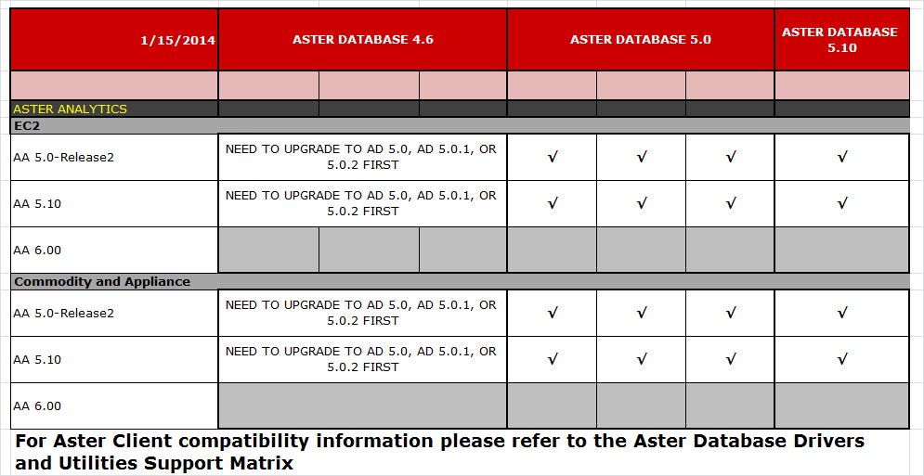
Aster Analytics

Slide 9
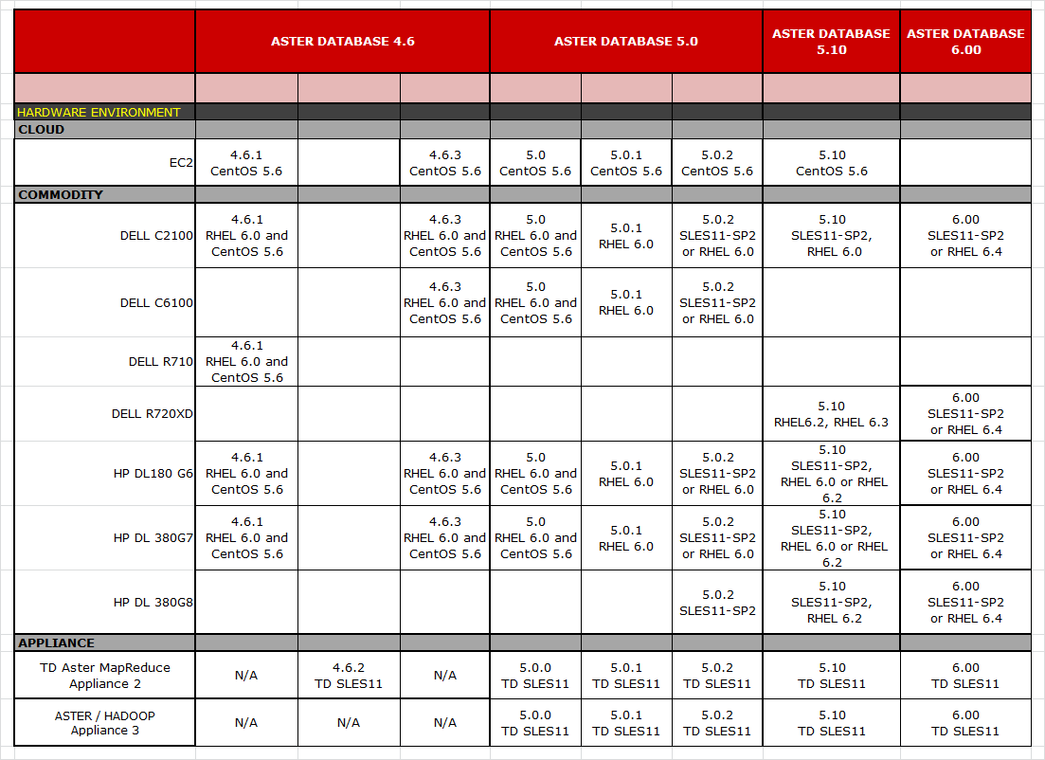
Aster Platform Roadmap

Slide 10
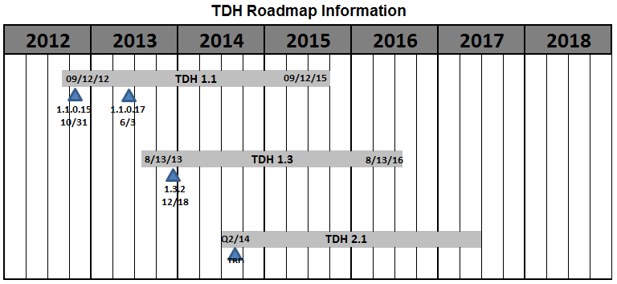
Hadoop Support Roadmap – Time Line

Slide 11
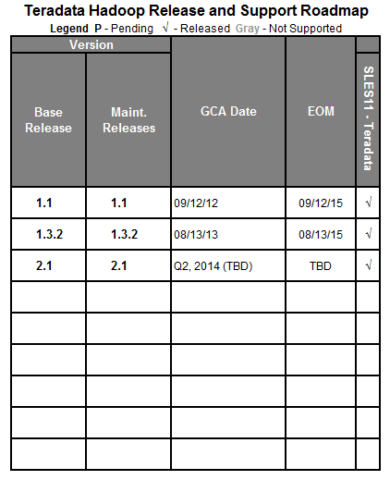
Hadoop Support Roadmap

Slide 12
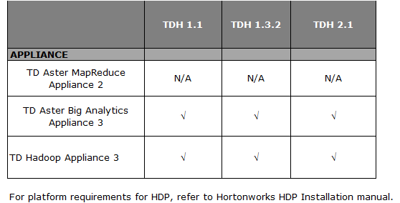
Hadoop Platform Compatibility

Slide 13
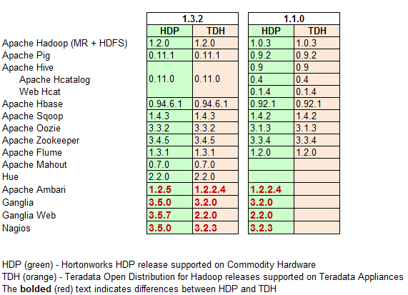
Teradata Hadoop Comparison To Hortonworks Hadoop

